Slide 1
Parallel PageRank Computation using CUDA
吕家明 李硕 邱实
2013 12. 13

Slide 2
PageRank
PageRank is an algorithm used by the Google web search engine to rank websites in their search engine results. PageRank was named after Larry Page, one of the founders of Google. PageRank is a way of measuring the importance of website pages.
PageRank works by counting the number and quality of links to a page to determine a rough estimate of how important the website is. The underlying assumption is that more important websites are likely to receive more links from other websites.
PageRank is a link analysis algorithm and it assigns a numerical weighting to each element of a hyperlinked set of documents, such as the World Wide Web, with the purpose of ‘measuring’ its relative importance within the set. The algorithm may be applied to any collection of entities with reciprocal quotations and references. The numerical weight that it assigns to any given element E is referred to as the PageRank of E and denoted by Other factors like Author Rank can contribute to PR(E) the importance of an entity.

Slide 3


PageRank
Simplified algorithm
i.e. the PageRank value for a page u is dependent on the PageRank values for each page v contained in the set B_{u} (the set containing all pages linking to page u), divided by the number L(v) of links from page v.
Damping Factor : The PageRank theory holds that an imaginary surfer who is randomly clicking on links will eventually stop clicking. The probability, at any step, that the person will continue is a damping factor d. Various studies have tested different damping factors, but it is generally assumed that the damping factor will be set around 0.85.

Slide 4
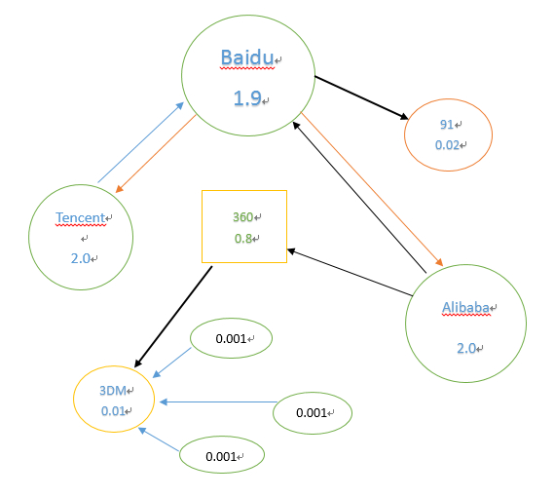
PageRank
Calculate the PageRank value
PR(Baidu) = 0.15 + 0.85 * (2.0/ 1 + 2.0 / 2)
ｄ: 0.85

Slide 5
PageRank
As we can see in the right picture. 3DM has been linked by 4 Pages . 91 has only 1 --- Baidu. In PageRank algorithm , the value of PR(E) both effect by the number of links and the weight of link .So the PR value of 91 almost equal to the value of 3DM, even though there is only one page link to it.
In PageRank algorithm , we can virtualize the complicate relationship of pages into directed graph ,It’s easy because we can handle each page as a vertex, and links as the edge.

Slide 6
PageRank
Virtualize the pages into directed graph
 | Baidu | Tencent | Alibaba | 360 | 91 | 3DM
Baidu | 0 | 1 | 1 | 0 | 1 | 0
Tencent | 1 | 0 | 0 | 0 | 0 | 0
Alibaba | 1 | 0 | 0 | 1 | 0 | 0
360 | 0 | 0 | 0 | 0 | 0 | 1
91 | 0 | 0 | 0 | 0 | 0 | 0
3DM | 0 | 0 | 0 | 0 | 0 | 0

Slide 7
PageRank
Begin
algorithm flow chart
Read data from Graph.txt, build Adjacency matrix
PageRank Calculation
Stable ?
Yes
END
No

Slide 8
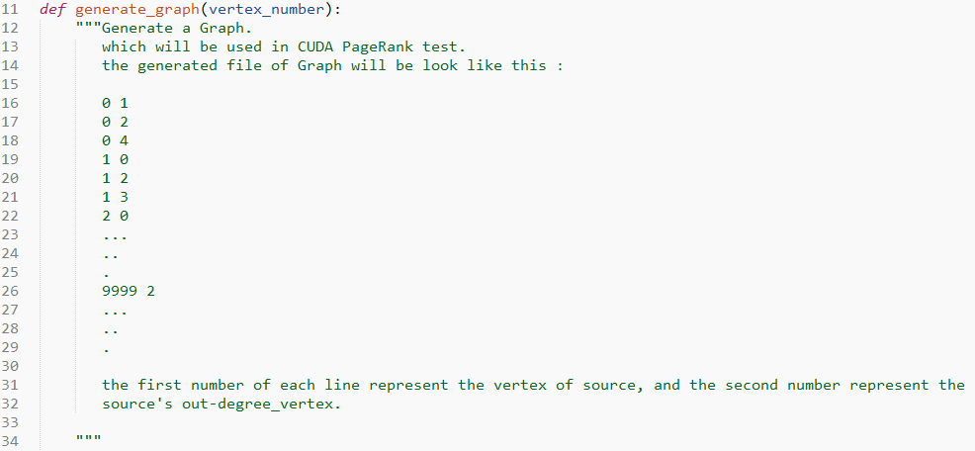
PageRank
Generate Data : generate_graph.py

Slide 9
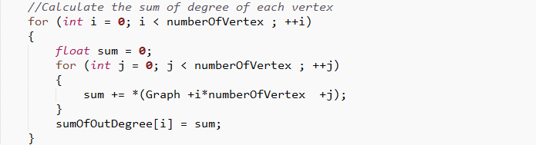
PageRank
CPU Routine Of PageRank
A: Calculate the sum of out degree of each vertex

Slide 10
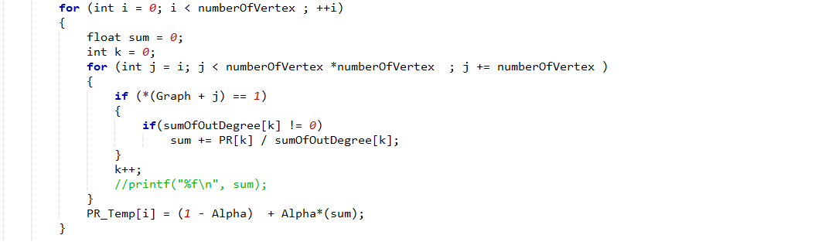
PageRank
CPU Routine Of PageRank
B: Calculate the new PageRank value, store in array PR_Temp

Slide 11
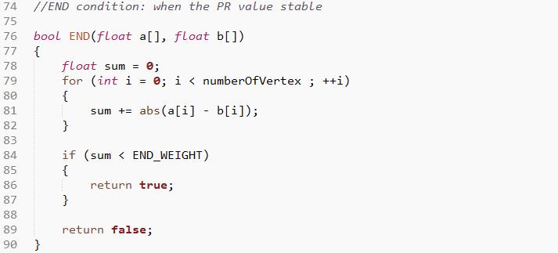
PageRank
CPU Routine Of PageRank
C: End Condition

Slide 12
PageRank
CUDA Routine Of PageRank : Simple but Effective!
Make a single vertex ‘s PageRank value calculation running in a single thread of CUDA
Vertex 0
Vertex 1
2
3
4
5
…….
Thread 0
Thread 1
Thread 2
Thread 3
Thread 4
Thread 5
Thread ….

Slide 13
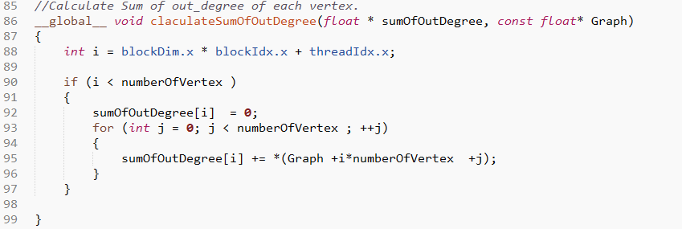
PageRank
CUDA Routine Of PageRank
A: Use CUDA to compute the sum of out degree

Slide 14
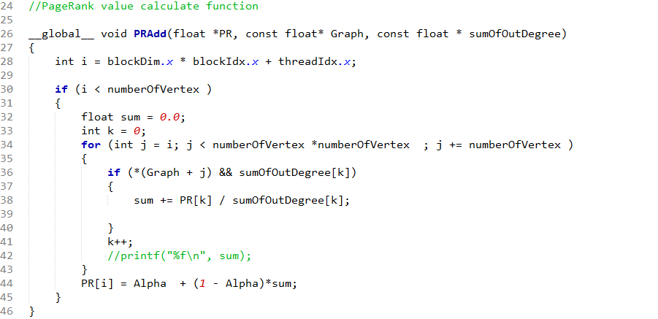
PageRank
CUDA Routine Of PageRank
B: Calculate the PageRank value.

Slide 15
So…
Where Amazing Happens…
PageRank
Jason Lyv

Slide 16
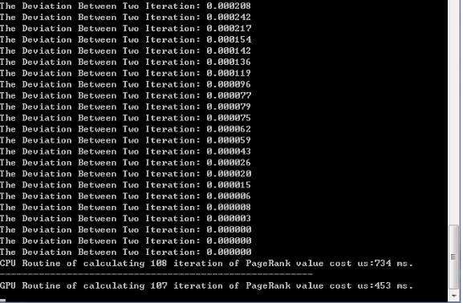
PageRank
Contrast between CPU and CUDA
Data: 500 * 500 Matrix
CUDA Runtime : 5.0
Number of Thread: 500
PageRank Value Initialization : 1
Number of Iteration:
CUDA: 108
CPU : 107
Compute Time:
CUDA: 453 ms
CPU : 734 ms

Slide 17
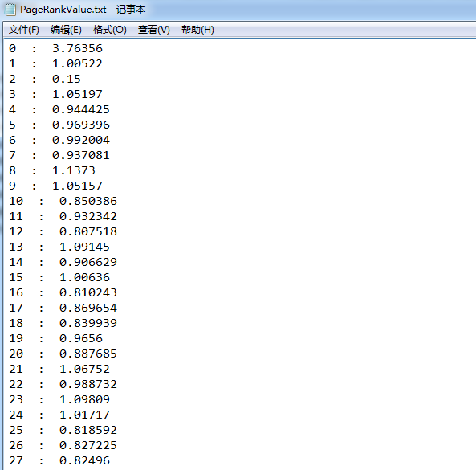
PageRank
Contrast between CPU and CUDA
CPU Routine
CUDA Routine

Slide 18
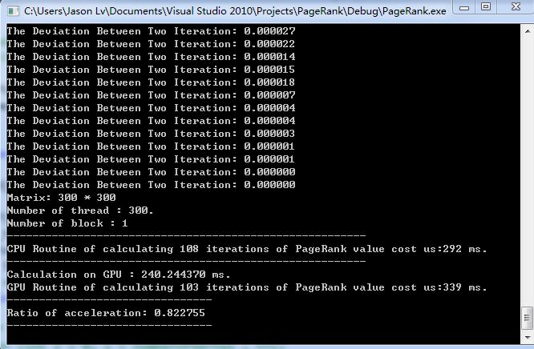
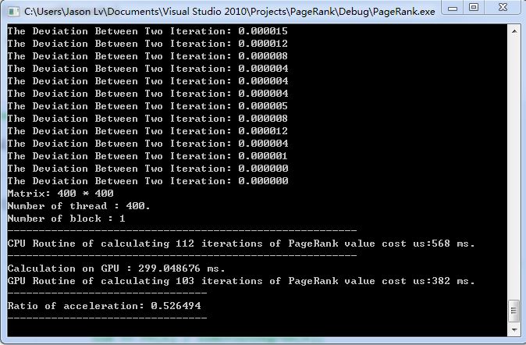
PageRank
Contrast between CPU and CUDA

Slide 19
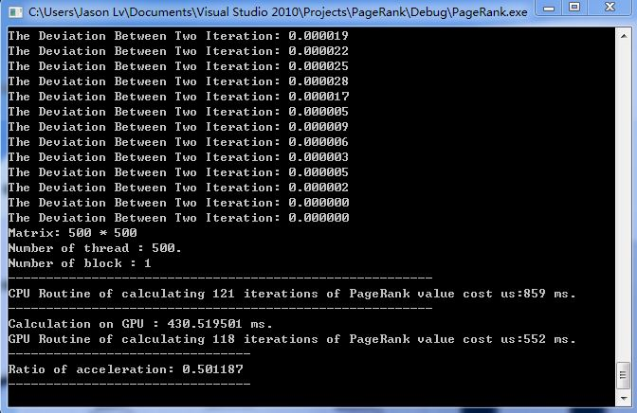
PageRank
Contrast between CPU and CUDA

Slide 20
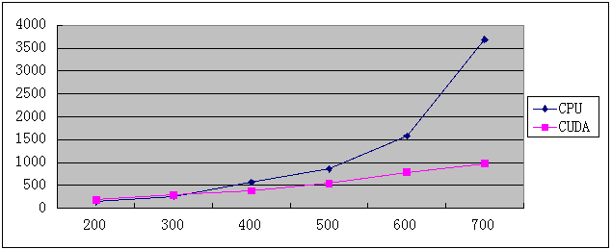
PageRank
Contrast between CPU and CUDA

Slide 21
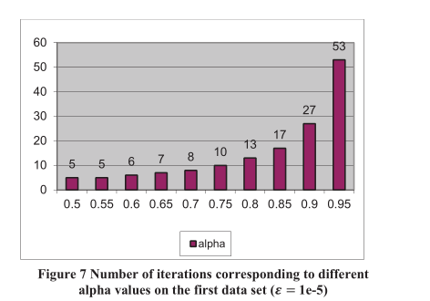
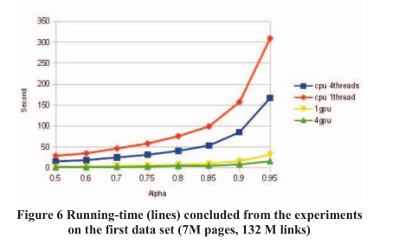
PageRank
Contrast between CPU and CUDA
More infomation: Parallel PageRank Computation using GPUs. [Nhat Tan Duong,Anh Tu Nguyen,Quang Anh Pham Nguyen,Huu-Duc Nguyen]

Slide 22
Parallel PageRank Computation using CUDA
Thanks!
吕家明
李硕
邱实

